Slide 1

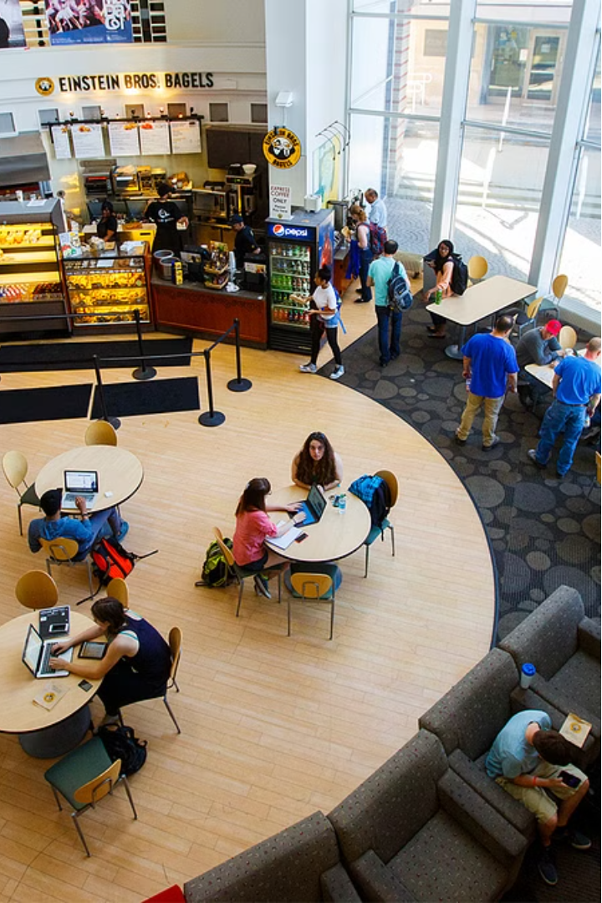

Campus Craving
Presented By:
Prince Kumar Mishra
Purwa
Harshit Raj
Garv Gupta

Slide 2
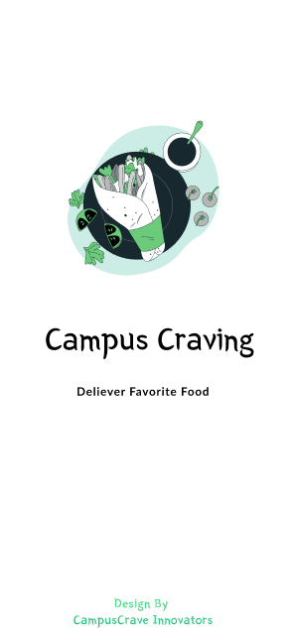

INTRODUCTION
Are you tired of the limited dining experience in your campus?
Do you find yourself craving your favorite foods late at night when you are lazy to move out of your bed?
Look no further than Campus Craving, the food delivery service designed specifically for college students.
We're here to provide you with a quick, convenient solution to your hunger.
With Campus Craving, you'll have access to a diverse selection of menus and cuisines, all available on demand. Whether you're studying late in the library or hanging out with friends in your dorm, we'll bring the food straight to you.

Slide 3


The problem Campus Craving solves:
Busy Student Schedules
Limited Campus Food Options
Juggling classes, clubs, and social life leaves little time for cooking.
Campus dining halls have limited hours and narrow menus.
Delivery Hassles
Dietary Restrictions
Off-campus food delivery can be unreliable and expensive.
Finding great-tasting meals that accommodate various needs is challenging.

Slide 4



Key Features: Quick, Convenient, Diverse Menus
Fast Delivery
Convenient Ordering
Diverse Menus
We guarantee lightning-fast delivery, so your food arrives hot and fresh.
Our mobile app and website make it easy to order from anywhere on campus.
Choose from a wide selection of cuisines to satisfy any craving.

Slide 5
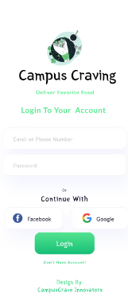
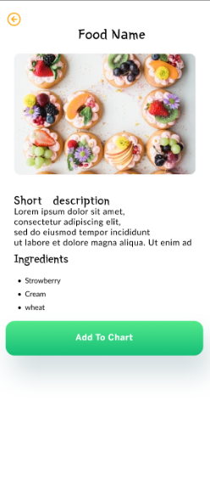

User-friendly Interface
Intuitive navigation and clear layout for easy ordering.
Seamless integration of search, filtering, and recommendations.
Visually appealing design with high-quality food imagery.

Slide 6
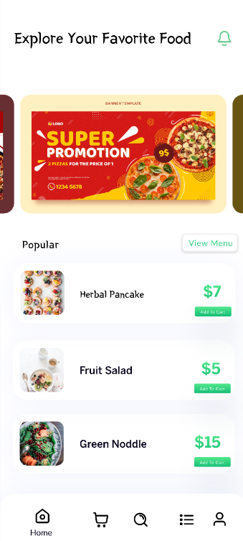
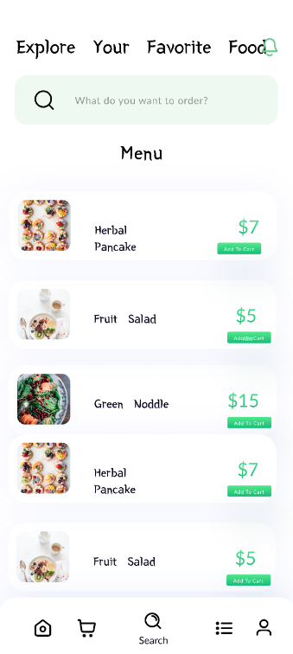
Diverse Menu Options
Offering a wide variety of cuisines to satisfy every craving
From classic burgers to authentic ethnic dishes, and everything in between
Vegetarian, vegan, and gluten-free options available for dietary needs
Customizable orders and the ability to build your own meal

Slide 7
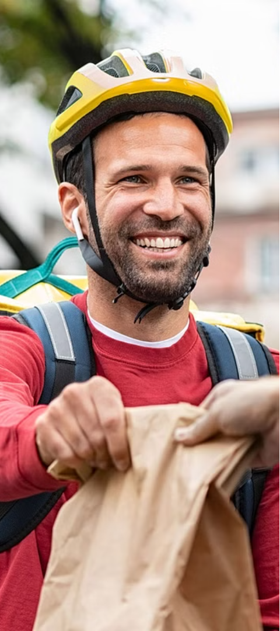
Efficient Delivery Process
1
Order Placement
Seamless in-app ordering experience
2
Route Optimization
Algorithms find fastest delivery paths
3
Real-Time Tracking
Live updates on driver location

Slide 8


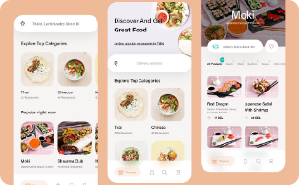
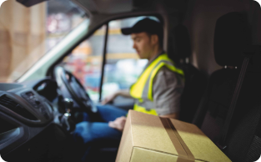
Partnerships with Local Restaurants
Diverse Cuisine Options
Mutually Beneficial Relationship
Seamless Integration
Reliable Delivery Service
Wide variety of global flavors from local eateries.
Increased visibility and sales for restaurants, convenient food options for students.
Feature restaurant menus and branding directly in the app.
Fast, contactless delivery of food from local partners.

Slide 9
Loyalty Program and Rewards
Earn Points
Exclusive Offers
Every order earns points towards rewards
Access to limited-time deals and discounts
Birthday Bonus
Referral Rewards
Receive a special treat on your birthday
Earn bonus points for referring friends

Slide 10
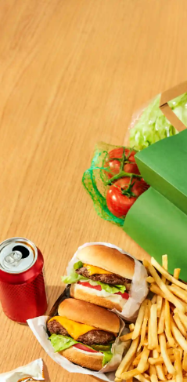
Objective:
Our objective is to provide a seamless and efficient food delivery service to students on campus, ensuring they have access to delicious meals wherever they are. We aim to:
Partner with local restaurants and eateries to offer a diverse menu selection.
Implement a user-friendly mobile app for easy ordering and tracking.
Deliver meals in a timely manner, ensuring freshness and quality.
Provide affordable pricing options to accommodate different budgets.
Offer personalized recommendations based on dietary preferences and restrictions.

Slide 11
Conclusion and Future Plans
Expand to More Campuses
Enhance Delivery Options
Partnerships and Integrations
Bring campusCraving to universities nationwide, catering to diverse student preferences.
Offer faster, more flexible delivery times to meet student schedules.
Collaborate with campus dining halls and student organizations for seamless experiences.

Slide 12
Thank You☺

